Slide 1
Hash Tables
Pro Academy I
Data Structure
Notes:
By leonardi.l

Slide 2
Definition
Hash table is improvement over DAT
It address the big space requirement for storing unique key on DAT
Hash Table reduce the requirement by allowing multiple key indexing using Hash Function
Hash Function is a function that return an exact index key for any input
Hash Function does not have to be able to return a unique index key for all the input
Hash Function may return a same index key for two different input

Slide 3
Operations
By allowing multiple key indexing, Hash Table must perform a collision handling
Ways to handle collision :
Chaining : Design each key cell to become a linked-list head
Open Addressing : If collision happens, increment the key index until empty slot are found
By doing this, Hash Tables perform insert, search and delete at average O(1)
Worst cases happens when the data is uniform, thus occupy only one key index, making it perform at O(n)
Notes:
* getMini(): It returns the root element of Min Heap. Time Complexity of this operation is O(1).
* extractMin(): Removes the minimum element from Min Heap. Time Complexity of this Operation is O(Logn) as this operation needs to maintain the heap property (by calling heapify()) after removing root.
* decreaseKey(): Decreases value of key. Time complexity of this operation is O(Logn). If the decreases key value of a node is greater than parent of the node, then we don’t need to do anything. Otherwise, we need to traverse up to fix the violated heap property.
* insert(): Inserting a new key takes O(Logn) time. We add a new key at the end of the tree. IF new key is greater than its parent, then we don’t need to do anything. Otherwise, we need to traverse up to fix the violated heap property.
* delete(): Deleting a key also takes O(Logn) time. We replace the key to be deleted with minum infinite by calling decreaseKey(). After decreaseKey(), the minus infinite value must reach root, so we call extractMin() to remove key.

Slide 4
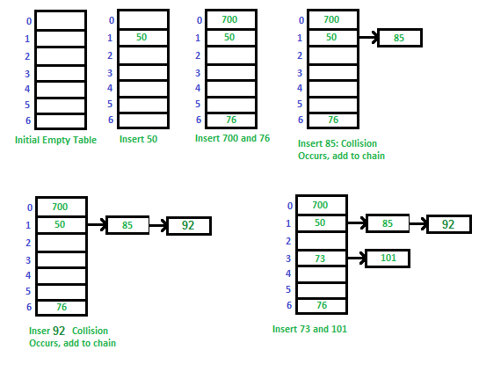
Chaining HT
consider a simple hash function as “key mod 7”

Slide 5
Chaining HT Algorithm
Insert
Search
Delete
Pretty much like simple linked list algorithm

Slide 6
Chaining HT
Advantages:
Simple to implement.
Hash table never fills up, we can always add more elements to chain.
Less sensitive to the hash function or load factors.
It is mostly used when it is unknown how many and how frequently keys may be inserted or deleted.
Disadvantages:
Cache performance of chaining is not good as keys are stored using linked list. Open addressing provides better cache performance as everything is stored in same table.
Wastage of Space (Some Parts of hash table are never used)
If the chain becomes long, then search time can become O(n) in worst case.
Uses extra space for links.

Slide 7
Chaining HT
m = Number of slots in hash table
n = Number of keys to be inserted in has table
Load factor α = n/m
Expected time to search = O(1 + α)
Expected time to insert/delete = O(1 + α)
Time complexity of search insert and delete is
O(1) if α is O(1)

Slide 8
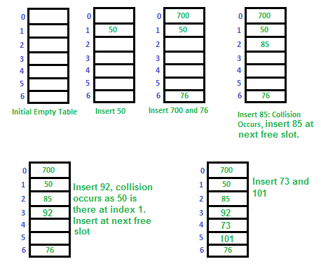
Open Adressing HT
consider a simple hash function as “key mod 7”

Slide 9
OA-HT Algorithm
Insert(k): Keep probing until an empty slot is found. Once an empty slot is found, insert k.
Search(k): Keep probing until slot’s key doesn’t become equal to k or an empty slot is reached.
Delete(k): If we simply delete a key, then search may fail. So slots of deleted keys are marked specially as “deleted”. Insert can insert an item in a deleted slot, but search doesn’t stop at a deleted slot.

Slide 10
OA-HT Collision
let hash(x) = hash function
let S be the table size
Linear Probing
If slot hash(x) % S is full, try (hash(x) + 1) % S
If (hash(x) + 1) % S is also full, try (hash(x) + 2) % S
If (hash(x) + 2) % S is also full, try (hash(x) + 3) % S
Quadratic Probing
If slot hash(x) % S is full, try (hash(x) + 1*1) % S
If (hash(x) + 1*1) % S is also full, try (hash(x) + 2*2) % S
If (hash(x) + 2*2) % S is also full, try (hash(x) + 3*3) % S
Double Hashing
use another hash function hash2(x)
If slot hash(x) % S is full, try (hash(x) + 1*hash2(x)) % S
If (hash(x) + 1*hash2(x)) % S is also full, try (hash(x) + 2*hash2(x)) % S
If (hash(x) + 2*hash2(x)) % S is also full, try (hash(x) + 3*hash2(x)) % S

Slide 11
OA-HT vs OA-Chaining
Advantages of Chaining:
Chaining is Simpler to implement.
In chaining, Hash table never fills up, we can always add more elements to chain. In open addressing, table may become full.
Chaining is Less sensitive to the hash function or load factors.
Chaining is mostly used when it is unknown how many and how frequently keys may be inserted or deleted.
Open addressing requires extra care for to avoid clustering and load factor.
Advantages of Open Addressing
Cache performance of chaining is not good as keys are stored using linked list. Open addressing provides better cache performance as everything is stored in same table.
Wastage of Space (Some Parts of hash table in chaining are never used). In Open addressing, a slot can be used even if an input doesn’t map to it.
Chaining uses extra space for links.

Slide 12
Hash Functions
Good Hash function is needed to reduce collision
Could be anything, as long at it returns the same key for the same value

Slide 13
Hash Function : djb2
unsigned long hash(unsigned char *str) {
unsigned long hash = 5381;
int c;
/* hash * 33 + c */
while (c = *str++)
hash = ((hash << 5) + hash) + c;
return hash;
}
Notes:
http://www.cse.yorku.ca/~oz/hash.html
http://www.azillionmonkeys.com/qed/hash.html
http://www.sparknotes.com/cs/searching/hashtables/section2/page/2/

Slide 14
Speed
Algorithm | Average | Worst Case
Space | O(n) | O(n)
Search | O(1) | O(n)
Insert | O(1) | O(n)
Delete | O(1) | O(n)

